Slide 1
Inter-VLAN Routing

Slide 2
What is inter-VLAN
VLANs are used to segment switched Layer 2 networks for a variety of reasons. Regardless of the reason, hosts in one VLAN cannot communicate with hosts in another VLAN unless there is a router or a Layer 3 switch to provide routing services.
Inter-VLAN routing is the process of forwarding network traffic from one VLAN to another VLAN.
There are three Inter-VLAN routing options:
Legacy Inter-VLAN routing: This is a legacy solution. It does not scale well.
Router-on-a-Stick: This is an acceptable solution for a small- to medium-sized network.
Layer 3 switch using switched virtual interfaces (SVIs): This is the most scalable solution for medium to large organizations.

Slide 3
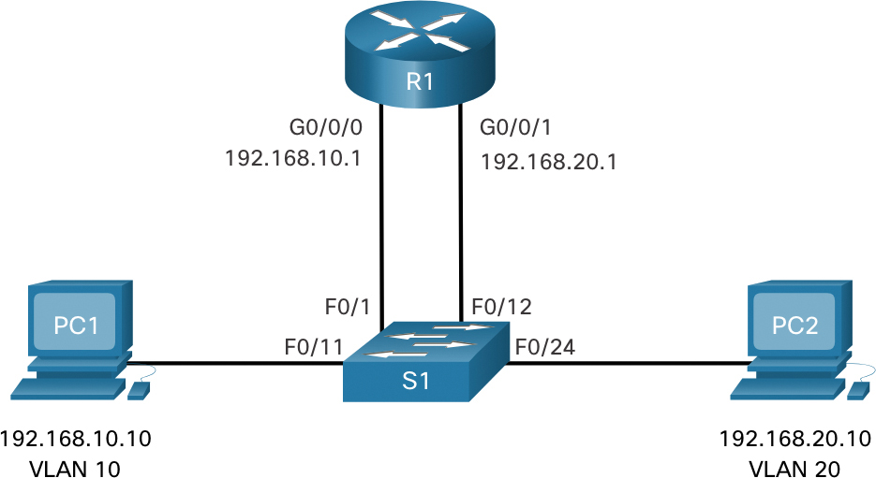
Legacy Inter-VLAN routing
The first inter-VLAN routing solution relied on using a router with multiple Ethernet interfaces. Each router interface was connected to a switch port in different VLANs. The router interfaces served as the default gateways to the local hosts on the VLAN subnet.

Slide 4
Legacy Inter-VLAN routing: Pros and Cons
Advantages
Disadvantages
Simple to implement
Cost-effective
Suitable for small networks
Works well with older hardware
No need for additional equipment
Limited scalability
Increased broadcast traffic
Lack of granular control
Security concerns
Performance degradation

Slide 5
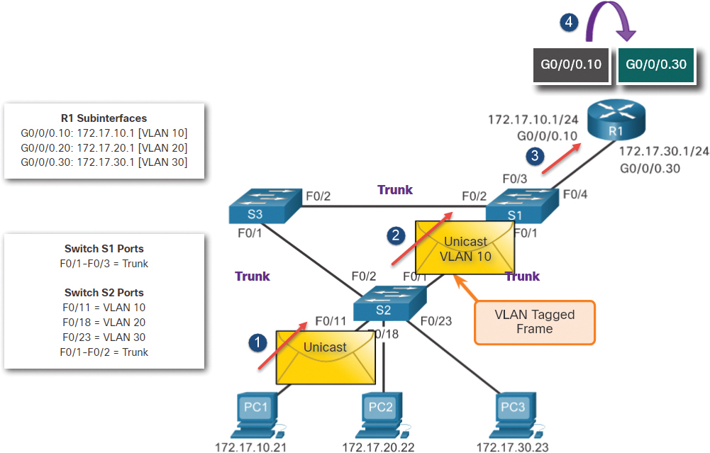
Router-on-a-Stick
The “router-on-a-stick” inter-VLAN routing method overcomes the limitation of the legacy inter-VLAN routing method. It requires only one physical Ethernet interface to route traffic between multiple VLANs on a network.
A Cisco IOS router Ethernet interface is configured as an 802.1Q trunk and connected to a trunk port on a Layer 2 switch. Specifically, the router interface is configured using sub-interfaces to identify routable VLANs.
Notes:
802.1Q trunk: The 802.1Q trunk is a networking technology used to carry multiple VLANs over a single physical link between network devices, typically switches. It's a standardized protocol defined by the IEEE 802.1Q standard.

Slide 6
Router-on-a-Stick: Pros and Cons
Advantages
Disadvantages
Scalability
Performance
Control
Flexibility
Features
Complexity
Single Point of Failure
Cost
Requirements
Additional Equipment

Slide 7
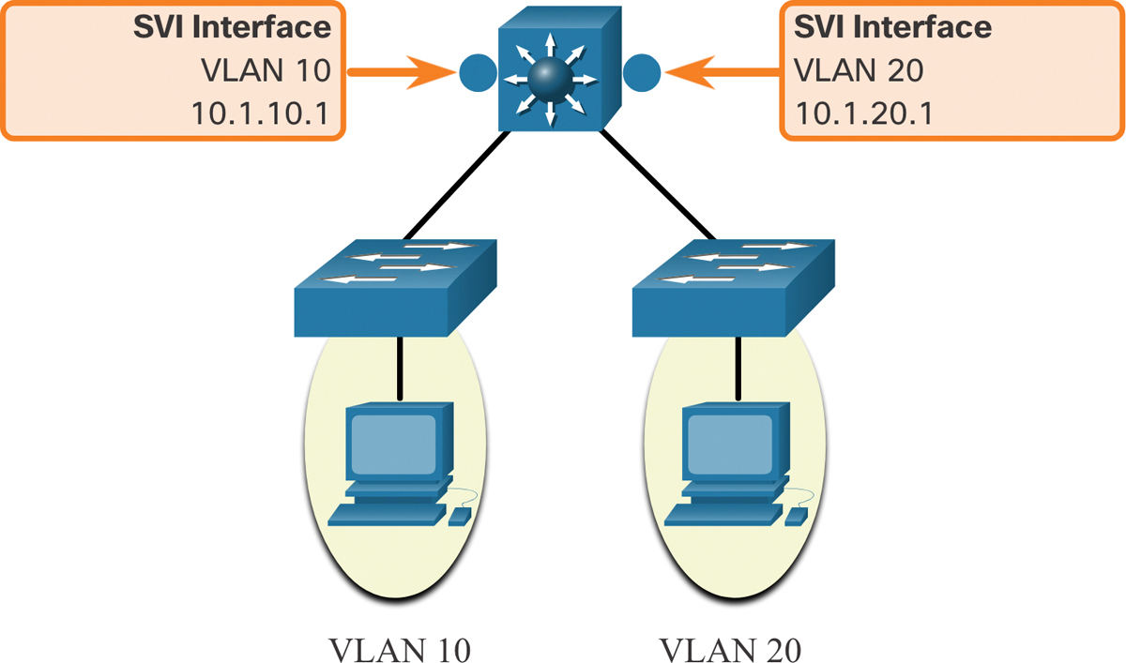
Layer 3 switch
The modern method of performing inter-VLAN routing is to use Layer 3 switches and switched virtual interfaces (SVI). An SVI is a virtual interface that is configured on a Layer 3 switch.
Inter-VLAN SVIs are created the same way that the management VLAN interface is configured.
The SVI is created for a VLAN that exists on the switch. Although virtual, the SVI performs the same functions for the VLAN as a router interface would.
Specifically, it provides Layer 3 processing for packets that are sent to or from all switch ports associated with that VLAN.
Notes:
802.1Q trunk: The 802.1Q trunk is a networking technology used to carry multiple VLANs over a single physical link between network devices, typically switches. It's a standardized protocol defined by the IEEE 802.1Q standard.

Slide 8
Layer 3 switch: Pros and Cons
Advantages
Disadvantages
Performance
Scalability
Efficiency
Control
Flexibility
Cost
Complexity
Limited Routing Features
Hardware Requirements
Single Point of Failure

